Slide 1
Digital Signal Processing Project-2 Chord Classifier
Presented By:
Nitheesh Kumar Manjunath
Hasib Al-Rashid
Saurin Shah

Slide 2
Goal of the Project
A guitar chord classifier is to be designed and implemented using MATLAB.
Several design constraints such as sampling frequency, speed optimization and accuracy are applied.
A fairly accurate but fast chord classifier is desired.

Slide 3
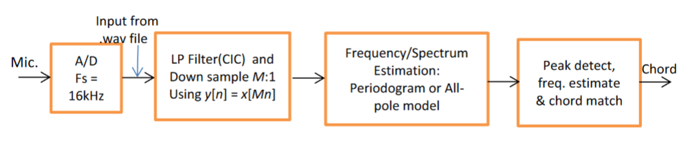
Design
Notes:
The Mic takes a 16kHz audio sample from the chord which it feeds to the CIC Anti aliasing filter with decimation. The Downsampler is the followed by Spectrum generation block.This block produces the Power density spectrum (PSD) of the signal. The next block is spectral estimation block which estimates the position of the peaks in the spectrum. The final block decides the chord and sends it as an output.

Slide 4
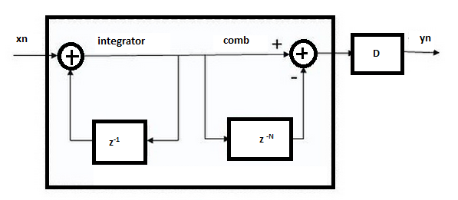
CIC filter Design
Decimation to a lower sampling rate is achieved by taking one sample out of every n samples. There exists an anti-aliasing Comb Integrator Cascaded (CIC) Filter before decimation. CIC anti aliasing filter rather than using multipliers only uses of subtractors and adders. Therefore it is very convenient to realize in hardware.
Figure: Cascaded Integrator Comb Filter

Slide 5
CIC filter Design
The impulse response of CIC filter is equivalent to moving average function which is a sinc function in frequency domain. The nulls appear at every +/- Sampling frequency (Fs) / Depth of filter.
Position of Nulls = +/- Sampling frequency (Fs) / Delay Buffer Depth (N)
After calculation: we found the values for N= 16 and D = 16 [Decimation factor]

Slide 6
Frequency Estimator Design
We tried with both of the method mentioned in the project description: FFT and All Pole Method
All pole method estimates frequency more accurately than FFT periodogram method
We used MATLAB built-in pburg function to do the all pole method and the model order is determined empirically by the function arburg.

Slide 7
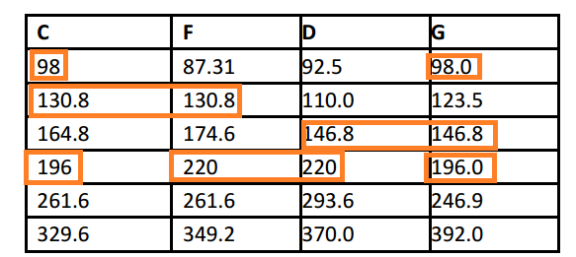
Peak Detector Design
From the power spectrum density highest maxima was determined for determining chord classification. However there are few situations when then first maxima overlap between two chords
Table: Frequency Overlapping of Chords

Slide 8
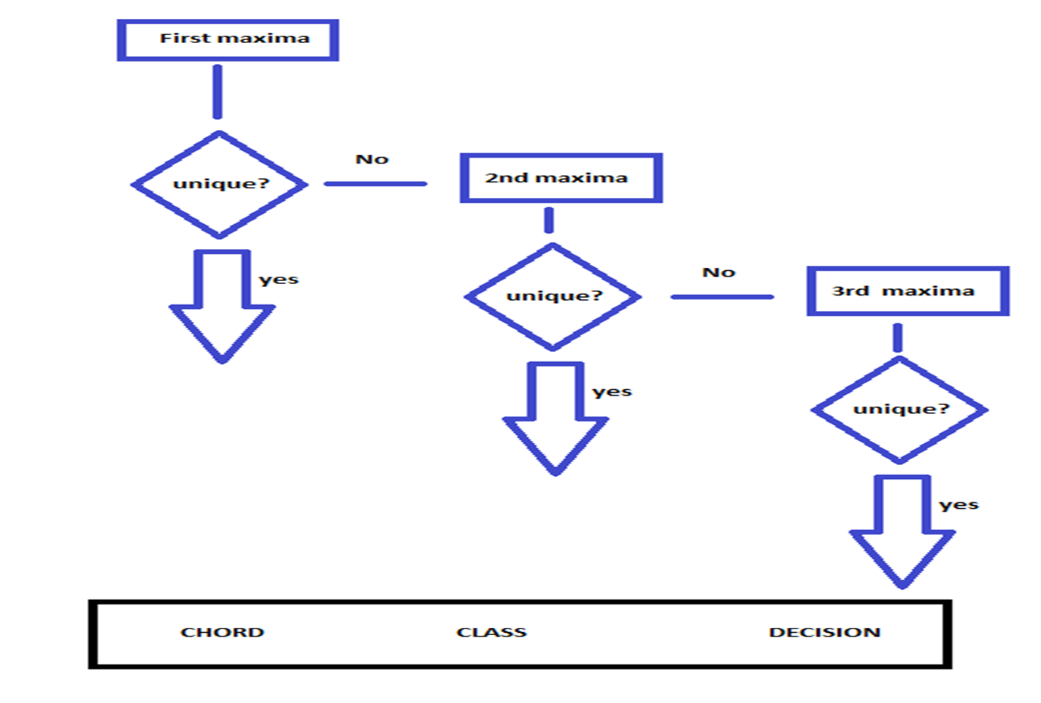
Peak Detector Design
In such cases we searched for up to 3th maxima and determined the chord class.

Slide 9
Results
Chord classification were tested with 12 samples and all of them were correct.
Average operation time 0.033 sec (for all pole method) and 0.048 sec (for periodogram method)
 | C | F | D | G
Data 1 ( _1) | SUCCESS | SUCCESS | SUCCESS | SUCCESS
Data 2 ( _2) | SUCCESS | SUCCESS | SUCCESS | SUCCESS
Data 3 ( _3) | SUCCESS | SUCCESS | SUCCESS | SUCCESS
Efficiency= 100%

Slide 10
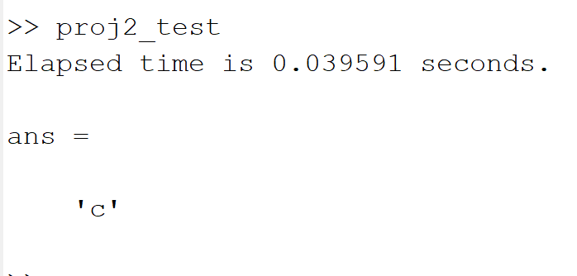
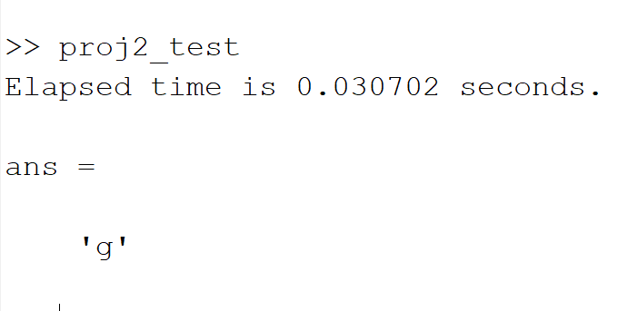
Results

Slide 11
Conclusions
In this project we learned how to implement CIC filter and frequency estimation methods to classify guitar chords.
All pole model and periodogram each in different circumstances may prove superior to its counterpart.
Therefore each time both models need to be designed for performance speculation.

Slide 12
Thank You

